Slide 1
Aspect Oriented Programming
The Dark Arts
Bailey Ling

Slide 2
Who am i?
Bailey Ling
Consultant at Lab49
Email: bling@lab49.com
Twitter: blingcoder
Blog: blingcode.blogspot.com

Slide 3
What is aop?
“In computing, aspect-oriented programming (AOP) is a programming paradigm which aims to increase modularity by allowing the separation of cross-cutting concerns”
- Wikipedia

Slide 4
Cross Cutting Concerns
What is that? Show me the code!
Notes:
Go through some code. Exceptions, logging, transactions.

Slide 5
Some Terms
Join point
Any part of execution where additional behavior can be usefully added.
Point cut
Many join points
Advice
A means to configure how point cuts are executed

Slide 6
Translation
How do I automatically get something to run before and after any method?
Proxy Pattern

Slide 7
Influences
Enterprise Library
Policy injection, Exception Handling, Validation, etc.
Code Contracts
ORMs (EF and NHibernate)
Change tracking, caching, lazy loading
And so on…

Slide 8
Options (in the .NET world)
 | Pros | Cons
Run-time Proxies | No impact on build time | Performance hit
Compile-time Weaving | Minimal to zero performance impact | Increased build time
Hybrid (LinFu)

Slide 9
Post-Build Weaving
Looks at compiled binaries and modifies the IL as necessary
Can add a significant time cost to the build process
PostSharp 2.1 CTP made signification improvements (only 3x slower)
Minimal performance impact
It should perform as good (or as bad) as if you wrote it manually

Slide 10
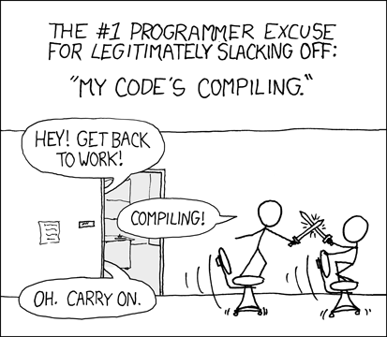

Slide 11
Dynamic Proxies
Built into the .NET Framework
ContextBoundObject
Open source libraries
Emits IL code at run time
Interfaces or virtual classes
Castle DynamicProxy, ObjectBuilder2, LinFu
Greater cost at creation of objects
Negligible impact on invocation

Slide 12
Creation Costs

Slide 13
Invocation Costs

Slide 14
Let’s Add Some Work!
public Constructor()
{
var tmp = Environment.MachineName;
}
public void SomeMethod()
{
var tmp = Environment.MachineName;
}

Slide 15
Creation /w Machine Name

Slide 16
Invocation /w Machine Name

Slide 17
Creation Costs Combined

Slide 18
Invocation Combined
Notes:
In 99.9% of real world scenarios, performance is not the reason to discount using dynamic proxies. If you think it the performance cost between a virtual and non-virtual call is significant you should reconsider using a language that’s not in a garbage collected virtual machine.

Slide 19
Castle DynamicProxy
Very mature library
NHibernate
Mocking libraries: Rhino, Moq, NSubstitute, etc.
Easy to use API
Advanced
Mixins!
Restricted by the language
Overriding virtual methods
Redirecting interface methods

Slide 20
Mixins
Easily accessible with dynamic languages
Syntax is simple and built into the language
Basically, you take a module A and you “mix it in” to your class, such that the class now has access to all methods defined in module A
Achieves benefits of multiple inheritance without the problems

Slide 21
Let’s go through a quick example

Slide 22
The Real Fun
It doesn’t stop there
Take it to the next level and do post-build modifications yourself
Make IL modifications directly and manually
Excellent open source library Mono.Cecil
The thing that powers a lot of tools we use every day
Reflector, ILSpy, Profilers, etc.
Even though mostly undocumented, easy to discover API
Extremely powerful

Slide 23

With Great Power Comes Great Responsibility
Notes:
With

Slide 24
Something we can all relate to…
WPF verbosity hell
INotifyPropertyChanged
Dependency Properties

Slide 25
WPF Example…

Slide 26
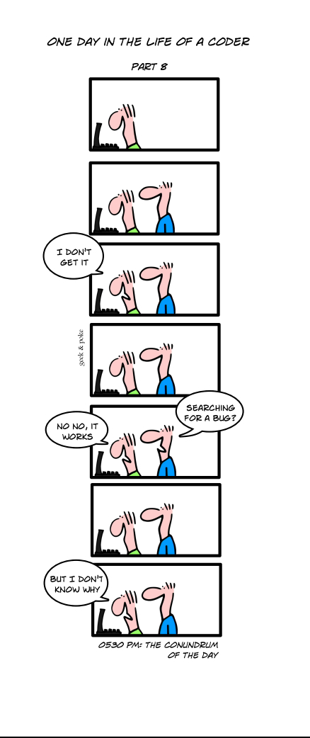
Cons
What you read is not necessarily what is executed
Arguably higher maintenance costs
No source code = No debugging
Write more tests!
Time consuming (when was the last time you wrote assembly?)
Notes:
Mention weaving INotifyPropertyChanged is not optimal because stuff happens behind the scenes. A better option is have something like IAutoWeaveNotifyPropertyChanged, which is documented fully.

Slide 27
Pros
You can shoot yourself in the foot, or you can shoot it at the target
Full control over performance
Generate cached instances of PropertyChangedEventArgs, without having to use a dictionary
Inline method calls
Etc.

Slide 28
Example Uses Besides Example Uses
Is there more to AOP than:
Logging, transactions, exceptions, cache, etc.
Deadlock detection
Custom ‘extended lock’ class which tracks the current thread ID
If Monitor.Enter takes longer than x seconds, it starts to do verbose logging, including stack traces of other threads
Mixed this into IDictionary
Metrics
Calculate average, max, min, standard deviation (and logging when out of confidence intervals)

Slide 29
Links
http://code.google.com/p/notifypropertyweaver/
Production-ready library for weaving INotifyPropertyChanged
https://github.com/bling/dependencypropertyweaver
MSBuild task I wrote that was born from this presentation
http://castle-project.org
Castle DynamicProxy
http://www.sharpcrafters.com
PostSharp
http://www.mono-project.com/Cecil
Mono.Cecil

Slide 30
https://github.com/bling/AOPDemo
Thanks!

